Slide 1
Video Contour Tracking
Wenshan Li
Yao Xie
Zhao Weng
Honglin Zheng

Slide 2
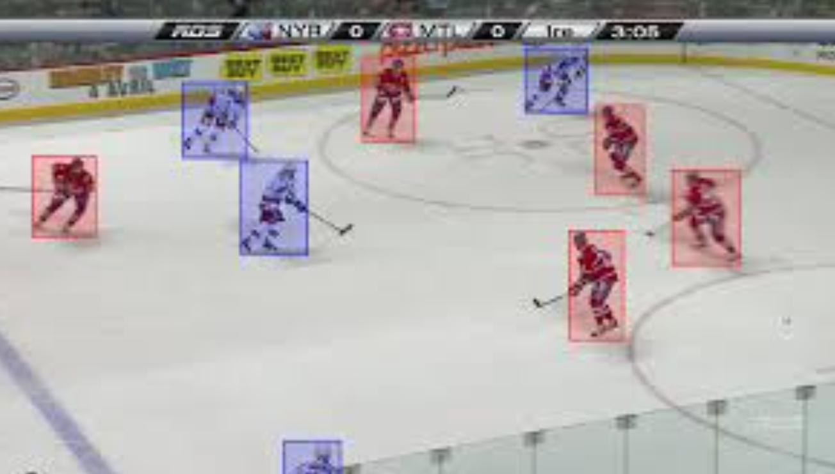
Motivation
Video tracking
The process of locating a moving object (or multiple objects) over time using a camera
Can be applied to human-computer interaction, security and surveillance, video communication and compression, augmented reality, traffic control, medical imaging and video editing

Slide 3
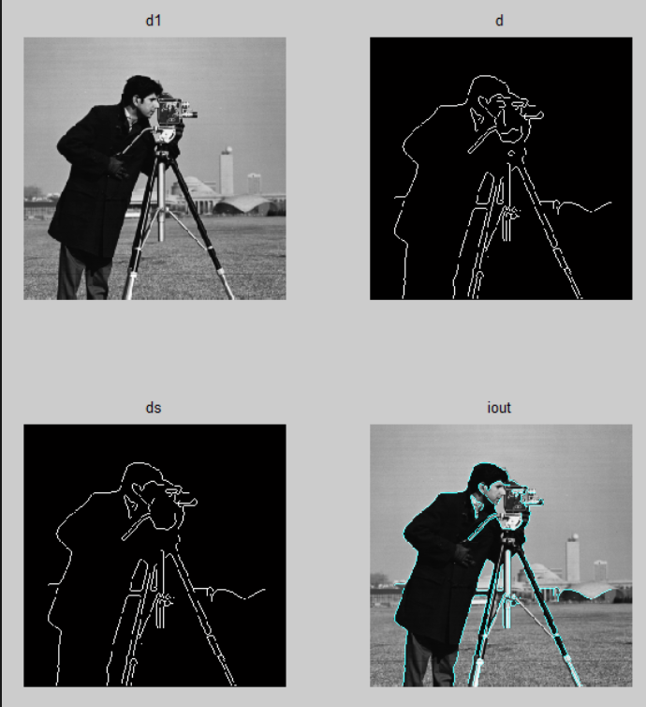
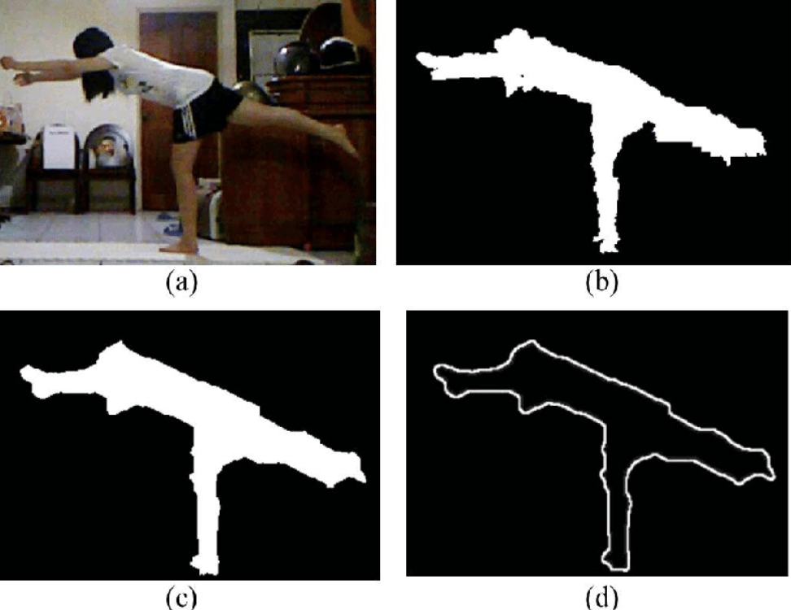
Motivation
Contour extraction
Contour tracing is a technique that is applied to digital images in order to extract their boundary
feature extraction process - an essential process in the field of pattern recognition.

Slide 4
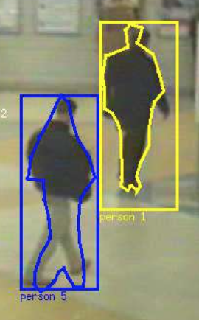
Challenges
State-of-the-art algorithms in both areas have limitations
Object tracking
only capture the position
general size of the moving - rectangle bounding box
Contour extraction
applied on a single image
We propose a method that incorporates two models
Identify both the moving objects and their fine-grained contours in a video

Slide 5
Methods Overview
Our project is decomposed into two phases:
Object detection and tracking
Contour extraction

Slide 6
Object Detection and Tracking
Motion-based tracking of moving objects in a stationary camera
This problem can be further decomposed into two parts:
detect moving objects in each frame
associate the detections correspond to the same object over time
Matlab computer vision system toolbox
Notes:
We are specifically targeting at the video shot by a stationary camera, which means that the background will be sitting still and we perform motion-based tracking of moving objects. (there are many other kind of tracking, size based, shape based, color based, but this motion based will be more robust)

Slide 7
Detect Moving Objects
Gaussian mixture models based background subtraction algorithm.
vision.ForegroundDetector(‘numGaussians’, 3, ‘NumTrainingFrames’, 40, ‘MinimumBackgroundRatio’, 0.7);
vision.BlobAnalysis(‘BoundingBoxOutput’, true, ‘AreaOutputPort’, true, ‘CentroidOutputPort’, true, ‘MinimumBlobArea’, 400);
Notes:
Firstly, we perform moving object detection in each frame. Here we use the foreground detector that comes with the vision system toolbox. Basically it use a gaussian mixture models to look through a number of consecutive frames and return the foreground mask, which is the moving objects.
Then we perform some blob analysis to group the foreground objects, connected components analysis.

Slide 8
Track Prediction, Assignment, Update and Deletion
Assigning object detections in the current frame to existing tracks is done by minimizing cost.
Compute the cost of assigning every detection to each track
Euclidean distance between the predicted centroid of the track(by Kalman filter) and the centroid of the detection
confidence of Kalman filter prediction
Solve the assignment problem using Hungarian algorithm
[assignments, unassignedTracks, unassignedDetections] = assignDetectionsToTracks(cost, costOfNonAssignment=20);
Notes:
After we obtain the detections, we start to align them to the existing tracks. And this is done by minimizing the cost of this assignment. We assign every detection to each track and calculate their cost, the cost is calculated by considering two factors, one is…, the other is….

Slide 9
Update Tracks, Delete Lost Tracks
For the assigned tracks, use the correct method of vision.KalmanFilter to correct the location estimate
correct(tracks(i).kalmanFilter, centroid)
track(i).age = track(i).age + 1
track(i).consecutiveInvisibleCount = 0
For the unassigned tracks
track(i).age = track(i).age + 1
track(i).consecutiveInvisibleCount += 1
Delete lost tracks:
delete tracks that have been invisible for too many consecutive frames
visibility = totalVisibleCount / ages
consecutiveInvisibleCount >= invisibleForTooLong
delete a track that visibility < 0.6 and invisible for over 20 consecutive frames

Slide 10
Create New Tracks
Create new tracks from unassigned detections.
Assume any unassigned detection is a start of a new track.
kalmanFilter = configureKalmanFilter(‘ConstantVelocity’, centroid, [200, 50], [100, 25], 100)

Slide 11
Tracking Results:
Demo video.
Save all the tracks information (location and size of bounding box) for fine-grained contour extraction.

Slide 12
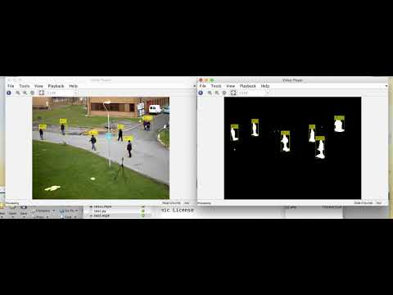

Slide 13
Contour Extraction
OpenCV is used to extract Contour
Topological Structural Analysis of Digitized Binary Images by Border Following
cv2.findContours(frame, cv2.RETR_EXTERNAL, cv2.CHAIN_APPROX_SIMPLE)

Slide 14
Contour Extraction
Background Subtraction and Bounding Boxes are utilized and compared to create better contour extraction
Gaussian Mixture-based Background/Foreground Segmentation Algorithm
fgbg = cv2.BackgroundSubtractorMOG()

Slide 15
Improvement Progress
Version 1. Directly subtract background, and find contours.
This gives a fair enough output, marks the contours of almost all the moving objects.
However, this has relatively more false contours, which we would like to call “ghosts”.

Slide 16
Improvement Progress
Version 2. First extract bounding box area, then subtract background, and finally find contours.
To avoid finding “ghosts”, we utilize the bounding boxes from the object detection phase as an assistant method. We treat the area in each bounding box as a new input, and find contours in it.
However, under such circumstances, it goes wrong when subtracting background.

Slide 17
Improvement Progress
Version 3. First subtract background, then extract bounding box area, and finally find contours.
To correctly subtract background, we first apply background subtraction on the whole picture, and then find contours in bounding box areas.
This produces much better results, but not perfect as shown afterwards.

Slide 18
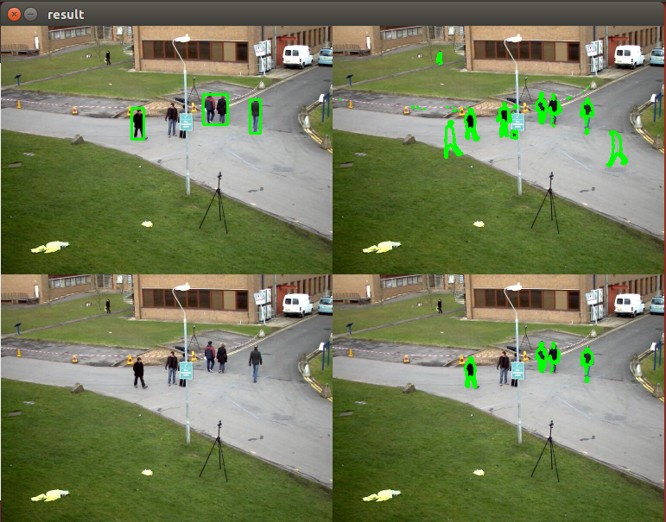

Slide 19
Demo

Slide 20
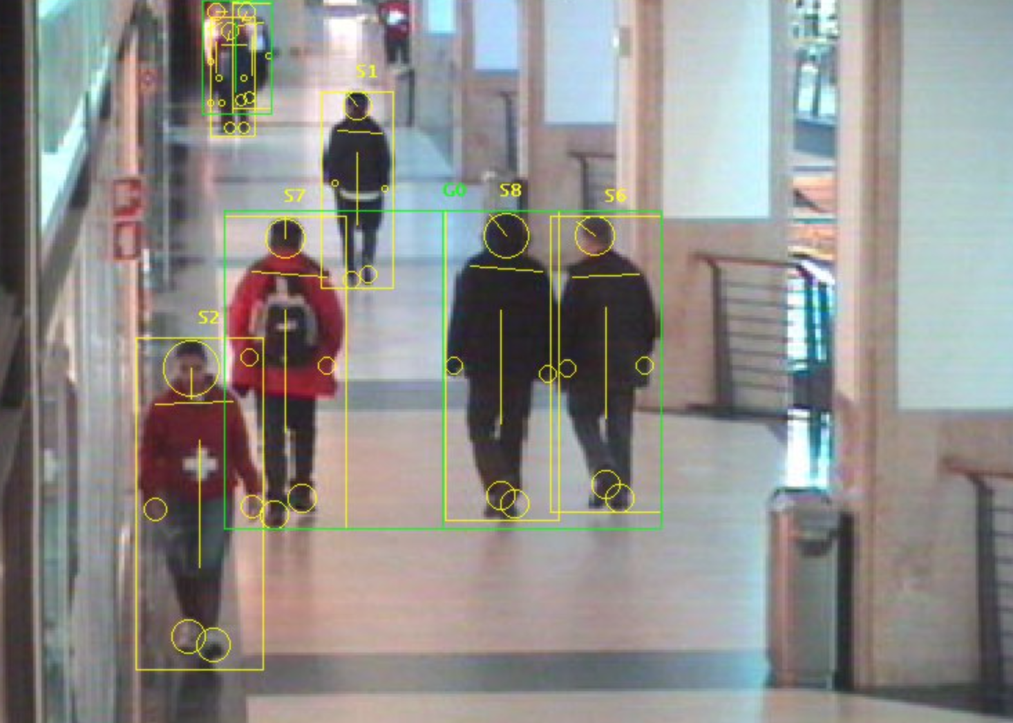
Dataset
Continue to run on the following dataset.
CAVIAR Test Case Scenarios
It consists of a number of video clips of different scenarios, including people walking alone, meeting with others, window shopping, entering and exiting shops, fighting and passing out, leaving a package in a public place, etc.

Slide 21
Future work
Consider deep learning methods for more accurate bounding boxes detection, contour detection, or background subtraction..
Handle object overlaps.
Refine the contour.
Improve the accuracy for both detection and contour finding.

